Slide 1
Online Retailer Recommender System
Ana Sofia Silva, number: 20200220
José Francisco Alves, number: 20200653
Miguel Nunes, number: 20200615
Mohammadali Gharghi, number: 20200997

Slide 2

Presentation Structure
Business Goals
Help users discover items they might not have found otherwise
Provide an easy choice that leads to a greater purchase
Increase the company’s sales
Expected Outcomes
Recommender system that appears in the website homepage and offers a wide range of relevant products to each user
Cold start: offer relevant products to new customers
Data Mining Goals
Collaborative Filtering for Implicit datasets using ALS;
Apriori recommender system and Association Rules
Recommender system model evaluation with Logistic Regression

Slide 3


Recommendation System
Prediction model built based on user’s experience
User reaches the website
Proceed with login, the customer ID will be detected and predicts items based on users previous bought and visit items
Model suggests complementary and similar items with recent bought items with a score that can be used for sorting suggested items

Slide 4



Cold start: offer relevant products to new customers
Website waits for the user to choose an item, then suggests similar predicts based on selected item
Recommendation System
Recommendation System based on the visitor ID

Slide 5

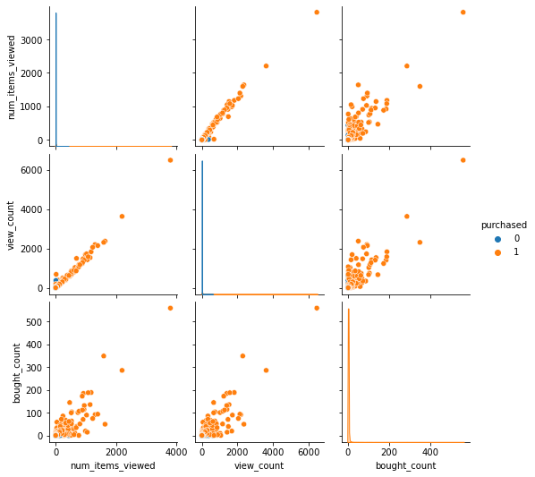
Evaluation strategies and quality measure
It is clear a linear relationship between the number of items viewed and the items purchased – the higher the view count, the higher the chances of that visitor buying something
Our model's accuracy in predicting buying visitors is around 80%

